Slide 1

Task 1 – Exploration Data Analysis
Data@ANZ Virtual Internship Program
Prepared by Brooks Musangu
1st October 2020

Slide 2
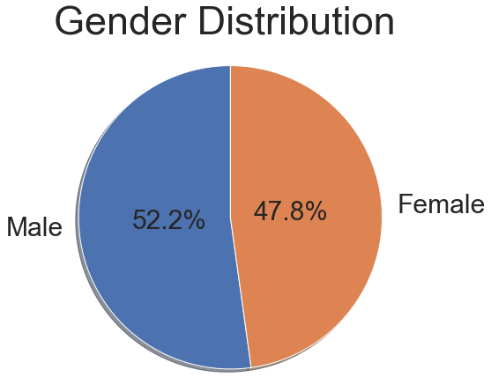
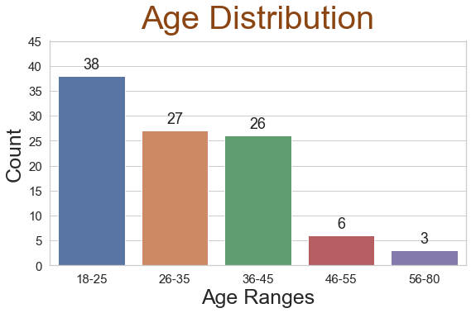
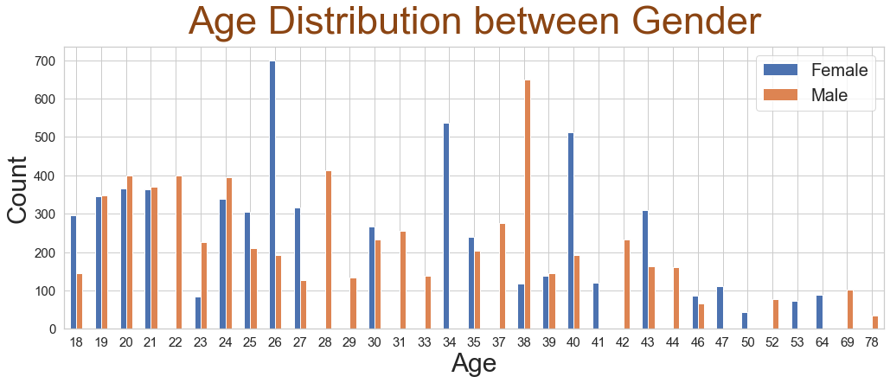
Customer Demographics
A total of 100 hypothetical customers.
Gender diversity is relatively even with males being the majority by only 2 %. An indication of unbiased service towards genders.
Average age 31 years.
Majority of the customers are younger, between the age of 18-35 year.
  Recommendation: Increase customer based for middle-age and elderly customers as they usually have higher income.

Slide 3
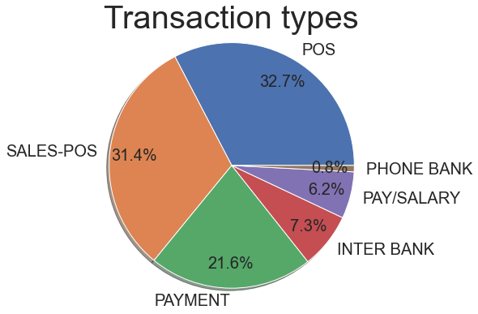
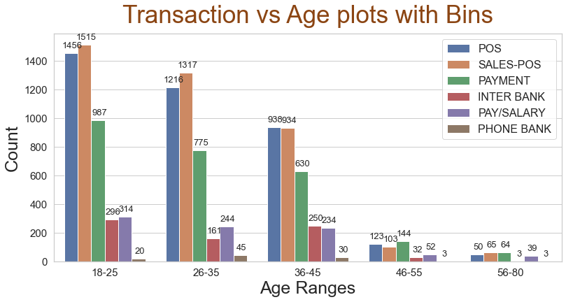
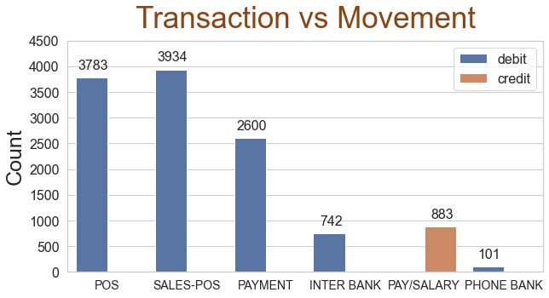
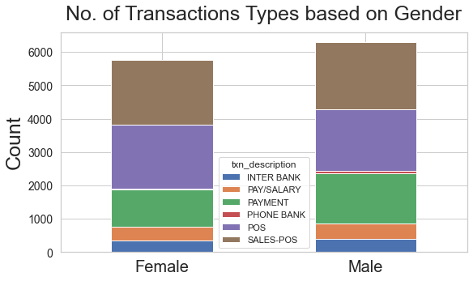
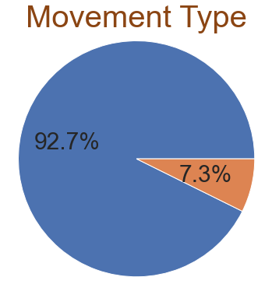
Transaction Insights
A total 12043 and an average transaction of 187.93 AUS
Transactions volume decreases significantly for Age > 40
Point of Sale (POS) transactions are the most popular transaction
Whereas, Phone Bank transactions are the lest popular type.
Recommendation: Increase phone banking support as the need might increase in the near future.
Credit is only in form of Salary/Pay giving credibility of data as we don’t see any anomalies in movement type.

Slide 4
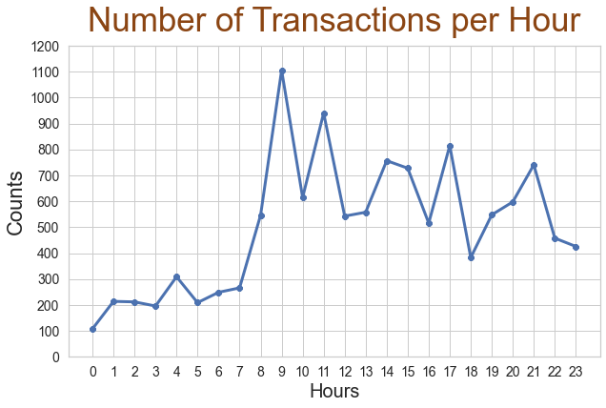
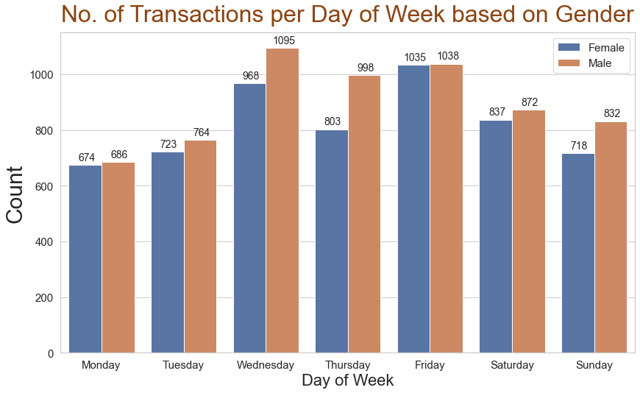
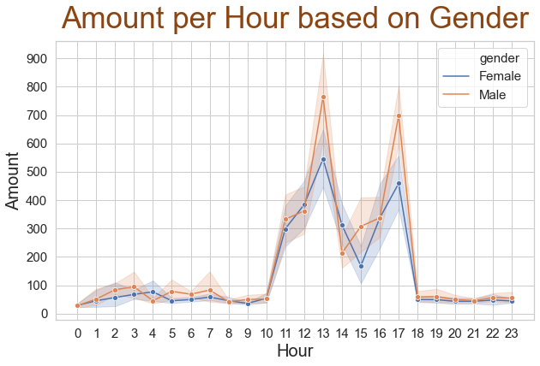
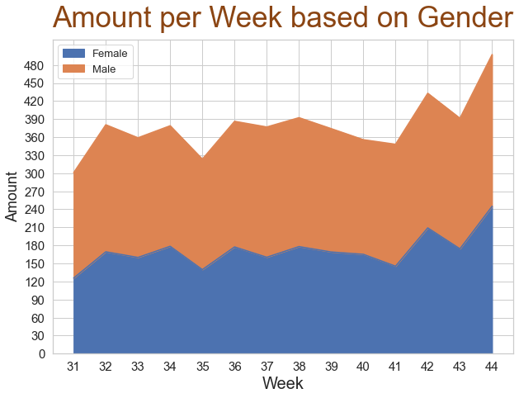
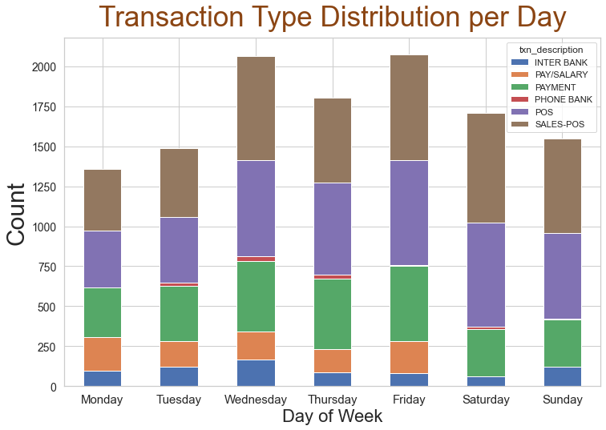
Transaction Insights Cont’d
Transaction peak time is around noon and minimal between 1 AM – 4 AM
Salaries are credited on Weekdays
Marginal difference between genders for number of transactions and average amount.
August appears to a holiday as there is no data

Slide 5
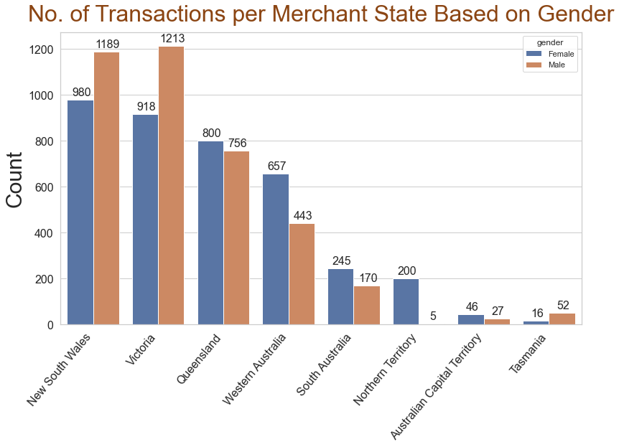
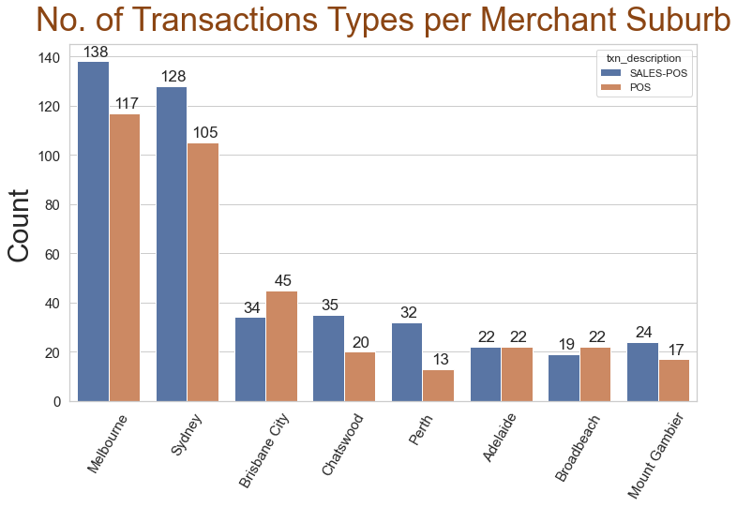
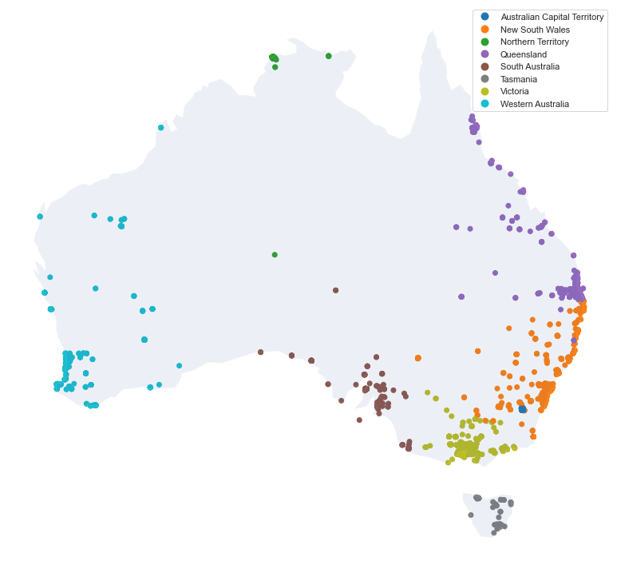
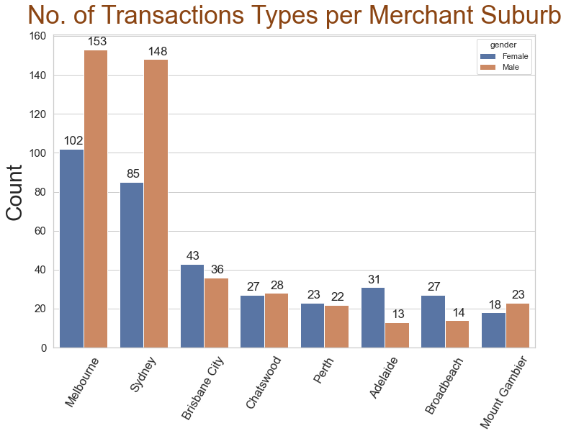
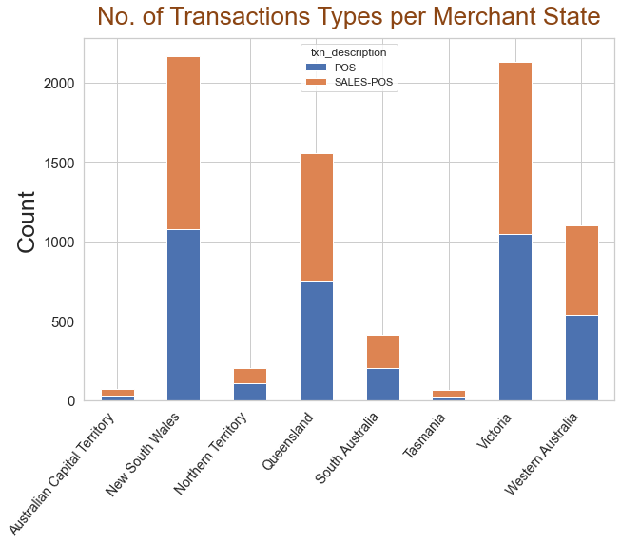
Transaction Based on Merchants
The only transactions in both states and suburbs are Point of Sale and Sales-Point of Sale transactions and there is a marginal difference in the number of transactions between genders.
The transaction volume is pretty low in other suburbs except for Melbourne and Sydney
Merchants are available across the country.

